Slide 1

SDE models for tumor population growth
Autors: Mahmoud B.A. Mansour, AsmaaH.Abobakr
Journal home page: Chaos, Solitons & Fractals
Volume 164, November 2022, 112738
Student Ortese Rita

Slide 2

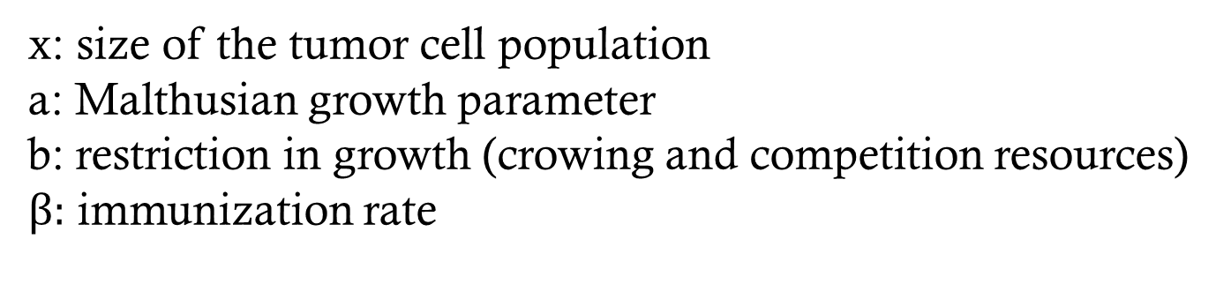
The general model
We consider the general tumor cell population growth model with immunization:
x: size of the tumor cell population
a: Malthusian growth parameter
b: restriction in growth (crowing and competition resources)
$β:$ immunization rate

Slide 3



The random fluctuations
The random fluctuations (iid about the path) affect the system through external parameters
The parameter a is regarded as a random variable in the from
So, we obtain the SDE:
{

Slide 4

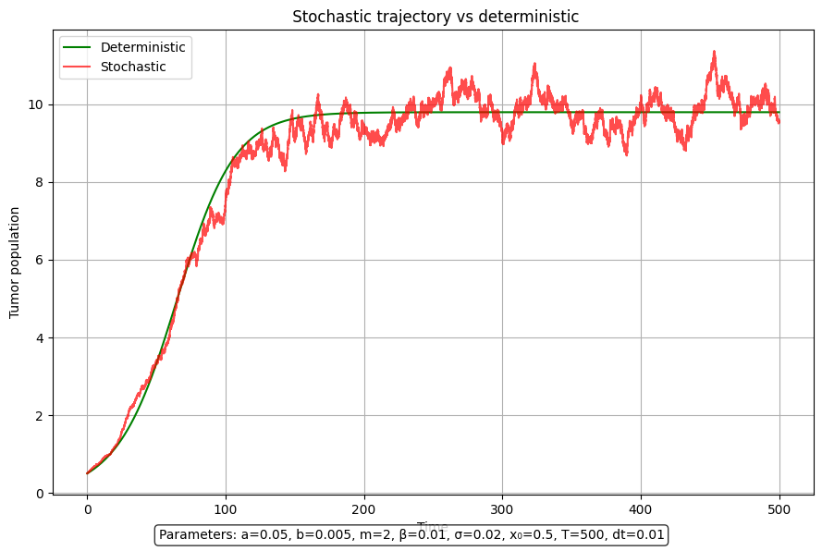



The solution of the sde
We apply the Euler-Maruyama algorithm, with the following discretization equation
With:
Z_{n}: N(0,1) for all n
n=1,2,…,N for sample size N

Slide 5
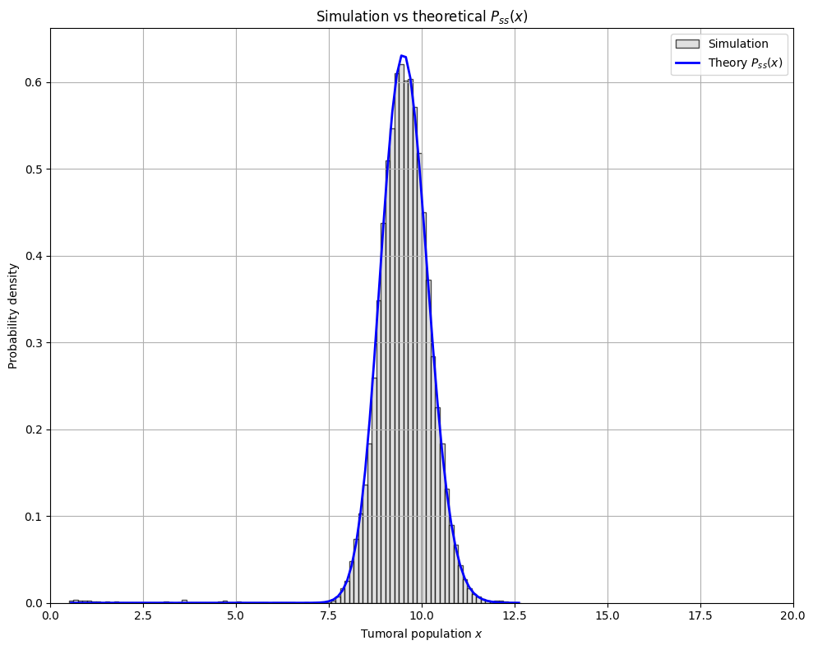



ANALYZIS for the solution process
The Fokker-Planck equation of the model is:
Where:
So, the steady state probability density is:

Slide 6
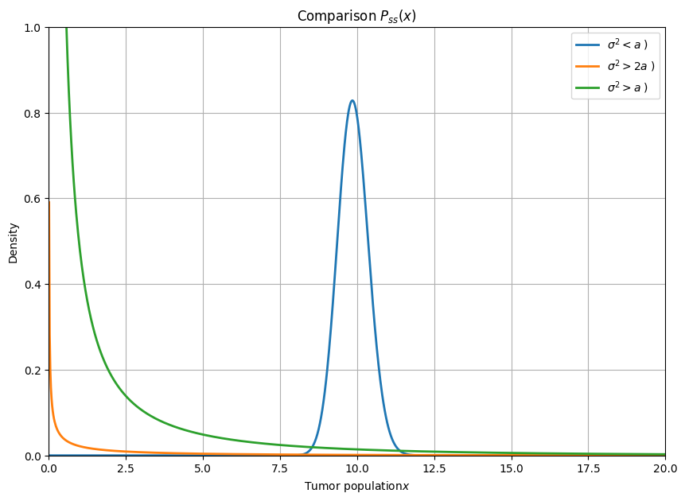
Behavior of the probability density
The SDE has a noise induced phase transition at x=0:
- If a < σ²/2 : x=0 is stable
- The point a = σ²/2 is a transition point: for a > σ²/2, x=0 becomes unstable and a new stationary probability appears (NIT)
If σ²/2 < a < σ: the steady state divergence at 0
If a > σ² : the density changes again, the point a = σ² is a second transition point

Slide 7
FURTHER ANALYSIS

Slide 8


Mean first passage time (MFPT)
The Mean First Passage Time (MFPT) is the expected time it takes for the stochastic process x_{t} to reach a critical threshold ε for the first time, starting from an initial condition x₀
The hitting time is:
Then:
It measure how long, on average, it takes for the system to reach extinction due to stochastic fluctuations:
Large: system resists noise
Small: system collapse under stochastic fluctuations

Slide 9




Analytical approximation via quadrature
The MFPT is computed using the Fokker-Planck equation and is approximated by:
Using:
Where:

Slide 10
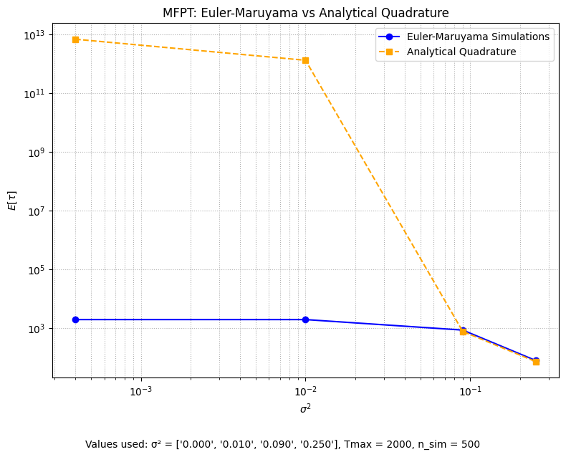

SIMULATION
We compare the analytical MFPT with the Euler-Maruyama method for different σ:
Start each trajectory form $x_{0}=0.5$
At each time step:
Stop when:
  $x_{t}<ε={10}^{−3}$
  $t≥Tmax$ (cut-off time)
Repeat for n=500 trajectories, compute average hitting time

Slide 11
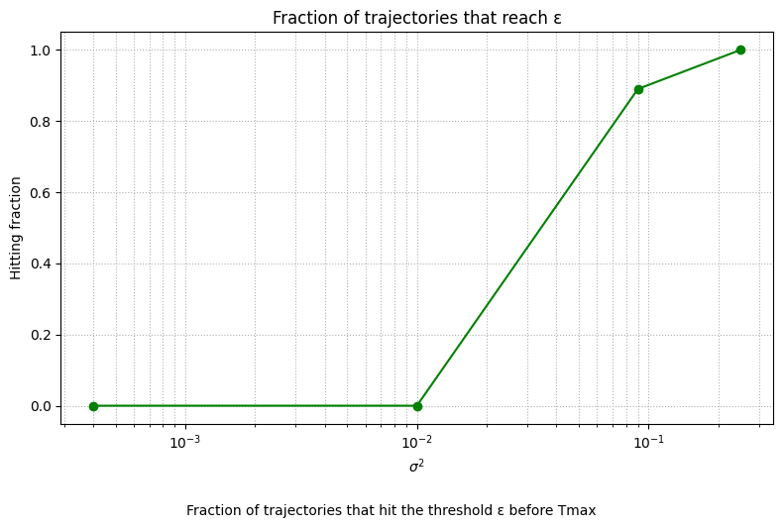
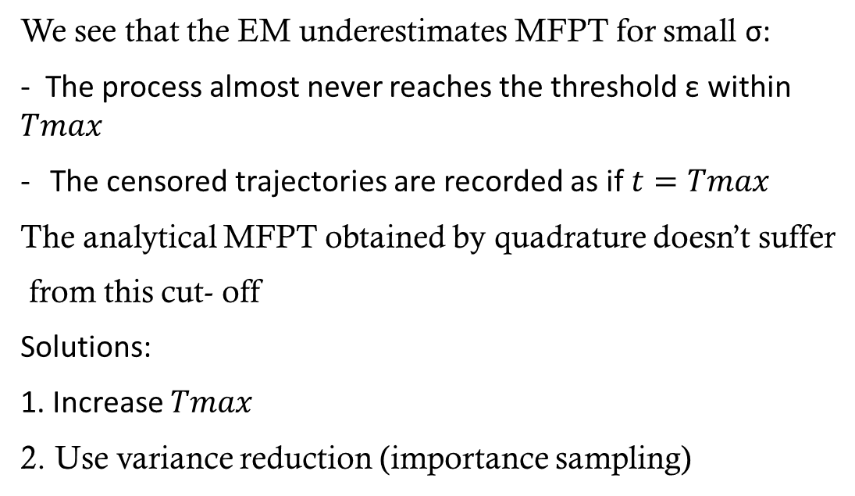
explanation
We see that the EM underestimates MFPT for small σ:
- The process almost never reaches the threshold ε within $Tmax$
The censored trajectories are recorded as if $t=Tmax$
The analytical MFPT obtained by quadrature doesn’t suffer
from this cut- off
Solutions:
1. Increase $Tmax$
2. Use variance reduction (importance sampling)

Slide 12
THANK YOU!

